Slide 1
File Management
File Concept
Access Methods
Disk and Directory Structure
File-System Mounting
File Sharing
Protection

Slide 2
Objectives
To explain the function of file systems
To describe the interfaces to file systems
To discuss file-system design tradeoffs, including access methods, file sharing, file locking, and directory structures
To explore file-system protection

Slide 3
File Concept
Contiguous logical address space
Types:
  Data
    numeric
    character
    binary
  Program
Contents defined by file’s creator
  Many types
    Consider text file, source file, executable file

Slide 4
File Attributes
Name – only information kept in human-readable form
Identifier – unique tag (number) identifies file within file system
Type – needed for systems that support different types
Location – pointer to file location on device
Size – current file size
Protection – controls who can do reading, writing, executing
Time, date, and user identification – data for protection, security, and usage monitoring
Information about files are kept in the directory structure, which is maintained on the disk
Many variations, including extended file attributes such as file checksum
Information kept in the directory structure

Slide 5

File info Window on Mac OS X

Slide 6
File Operations
File is an abstract data type
Create
Write – at write pointer location
Read – at read pointer location
Reposition within file - seek
Delete
Truncate
Open(F_{i}) – search the directory structure on disk for entry F_{i}, and move the content of entry to memory
Close (F_{i}) – move the content of entry F_{i} in memory to directory structure on disk

Slide 7
Open Files
Several pieces of data are needed to manage open files:
  Open-file table: tracks open files
  File pointer: pointer to last read/write location, per process that has the file open
  File-open count: counter of number of times a file is open – to allow removal of data from open-file table when last processes closes it
  Disk location of the file: cache of data access information
  Access rights: per-process access mode information

Slide 8
Open File Locking
Provided by some operating systems and file systems
  Similar to reader-writer locks
  Shared lock similar to reader lock – several processes can acquire concurrently
  Exclusive lock similar to writer lock
Mediates access to a file
Mandatory or advisory:
  Mandatory – access is denied depending on locks held and requested
  Advisory – processes can find status of locks and decide what to do

Slide 9
File Locking Example – Java API
import java.io.*;
import java.nio.channels.*;
public class LockingExample {
public static final boolean EXCLUSIVE = false;
public static final boolean SHARED = true;
public static void main(String arsg[]) throws IOException {
FileLock sharedLock = null;
FileLock exclusiveLock = null;
try {
RandomAccessFile raf = new RandomAccessFile("file.txt", "rw");
// get the channel for the file
FileChannel ch = raf.getChannel();
// this locks the first half of the file - exclusive
exclusiveLock = ch.lock(0, raf.length()/2, EXCLUSIVE);
/** Now modify the data . . . */
// release the lock
exclusiveLock.release();

Slide 10
File Locking Example – Java API (Cont.)
// this locks the second half of the file - shared
sharedLock = ch.lock(raf.length()/2+1, raf.length(), SHARED);
/** Now read the data . . . */
// release the lock
sharedLock.release();
} catch (java.io.IOException ioe) {
System.err.println(ioe);
}finally {
if (exclusiveLock != null)
exclusiveLock.release();
if (sharedLock != null)
sharedLock.release();
}
}
}

Slide 11

File Types – Name, Extension

Slide 12
File Structure
File types -indicate the internal structure of the file.
Disadvantage: If operating system is required support multiple file structure then the resulting size of the operating system is increases.
Some operating systems like UNIX, Windows, impose (and support) a minimal number of file structures. (Windows – open file with, associate the program with file type)
Internal File Structure:
Disk systems have a well-defined block size determined by the size of a sector. All disk I/O is performed in units of one block and all blocks are the same size.
UNIX operating system defines all files to be simply streams of bytes. Each byte is individually addressable by its offset from the beginning (or end) of the file. In this case, the logical record size is 1 byte. The file system automatically packs and unpacks bytes into physical disk blocks
The logical record size, physical block size, and packing technique deter- mine how many logical records are in each physical block.
All the basic I/O functions operate in terms of blocks.

Slide 13

Access Methods-Sequential
Information in the file is processed in order, one record after the other.
Examples- editors and compilers usually access files in this fashion.
read next()— reads the next portion of the file and automatically advances a file pointer, which tracks the I/O location.
Similarly, the write operation, write next()— appends to the end of the file
Sequential access, is based on a tape model of a file and works as well on sequential-access devices as well as random-access devices.

Slide 14
Access Methods- Direct Access
Direct Access:
In direct access file is made up of fixed-length logical records.
The direct-access method is based on a disk model of a file, since disks allow random access to any file block.
There are no restrictions on the order of reading or writing for a direct-access file.
When a query concerning a particular subject arrives, we compute which block contains the answer and then read that block directly to provide the desired information.
We have include the block number as a parameter i.e. we have read(n), where n is the block number, rather than read next(), and write(n) rather than write next().
n = relative block number(is an index relative to the beginning of the file. )
Relative block numbers allow OS to decide where file should be placed

Slide 15

Simulation of Sequential Access on Direct-access File
We can easily simulate sequential access on a direct-access file by simply keeping a variable cp that defines our current position.
Simulating a direct-access file on a sequential-access file, however, is extremely inefficient.

Slide 16
Other Access Methods
Can be built on top of base methods
In general involve creation of an index for the file
The index, contains pointers to the various blocks.
Keep index in memory for fast determination of location of data to be operated on
If file is too large, create an index for the index file
Example:
IBM indexed sequential-access method (ISAM)
  uses a small master index that points to disk blocks of a secondary index.
  The secondary index blocks point to the actual file blocks.
  File kept sorted on a defined key
  To find a particular item, we first make a binary search of the master index, which provides the block number of the secondary index.

Slide 17

Example of Index and Relative Files

Slide 18
Directory Structure
A collection of nodes containing information about all files
Directory
Files
F 1
F 2
F 3
F 4
F n
Both the directory structure and the files reside on disk

Slide 19
Disk Structure
Disk can be subdivided into partitions.
Partitioning is useful for:
limiting the sizes of individual file systems,
putting multiple file-system types on the same device,
leaving part of the device available for other uses, such as swap space or unformatted (raw) disk space.
Disks or partitions can be RAID (Redundant Arrays of Independent Disks) protected against failure
Disk or partition can be used raw – without a file system, or formatted with a file system
Any entity containing a file system is generally known as a volume.
Volumes can also store multiple operating systems(e.g. Windows and Linux), allowing a system to boot and run more than one operating system.

Slide 20
Disk Structure Contd.
Each volume containing file system also tracks that file system’s info in device directory or volume table of contents
As well as general-purpose file systems there are many special-purpose file systems, frequently all within the same operating system or computer

Slide 21

A Typical File-system Organization

Slide 22
Types of File Systems
We mostly talk of general-purpose file systems
But systems frequently have may file systems, some general- and some special- purpose
Consider Solaris has
  tmpfs – memory-based volatile FS for fast, temporary I/O
  objfs – interface into kernel memory to get kernel symbols for debugging
  ctfs – contract file system for managing daemons
  lofs – loopback file system allows one FS to be accessed in place of another
  procfs – kernel interface to process structures
  ufs, zfs – general purpose file systems

Slide 23
Operations Performed on Directory
Search for a file-search a directory structure to find the entry for a particular file.
Create a file-New files need to be created and added to the directory.
Delete a file-
List a directory-list the files in a directory and the contents of the directory entry for each file in the list.
Rename a file-
Traverse the file system

Slide 24
Directory Organization
The directory is organized logically to obtain:
Efficiency – locating a file quickly
Naming – convenient to users
  Two users can have same name for different files
  The same file can have several different names
Grouping – logical grouping of files by properties, (e.g., all Java programs, all games, …)

Slide 25

Single-Level Directory
A single directory for all users
Naming problem

Slide 26

Two-Level Directory
In the two-level directory structure, each user has his own user file directory (UFD).
When a user refers to a particular file, only his own UFD is searched.
When a user job starts or a user logs in, the system’s master file directory (MFD) is searched
Path name
Can have the same file name for different user
Efficient searching
No grouping capability

Slide 27

Tree-Structured Directories
The tree has a root directory, and every file in the system has a unique path name.
A directory is simply another file, but it is treated in a special way.
One bit in each directory entry defines the entry as a file (0) or as a subdirectory (1).

Slide 28
Tree-Structured Directories (Cont.)
When reference is made to a file, the current directory is searched. If a file is needed that is not in the current directory, then the user usually must either specify a path name or change the current directory to be the directory holding that file.
Efficient searching
Grouping Capability
Path names can be of two types: absolute and relative:
An absolute path name begins at the root and follows a path down to the specified file, giving the directory names on the path.
A relative path name defines a path from the current directory.
Current directory (working directory
Deletion of a directory:
To delete a directory, the user must first delete all the files in that directory.
With a tree-structured directory system, users can be allowed to access, in addition to their files, the files of other users.

Slide 29

Tree-Structured Directories (Cont)
Absolute or relative path name
Creating a new file is done in current directory
Delete a file
rm <file-name>
Creating a new subdirectory is done in current directory
  mkdir <dir-name>
  Example: if in current directory /mail
  mkdir count
Deleting “mail” ⇒ deleting the entire subtree rooted by “mail”

Slide 30

Acyclic-Graph Directories
Have shared subdirectories and files

Slide 31
Acyclic-Graph Directories (Cont.)
With a shared file, only one actual file exists, so any changes made by one person are immediately visible to the other.
Shared files and subdirectories can be implemented using directory entry called a link.
A link is effectively a pointer to another file or subdirectory.
When a reference to a file is made, we search the directory. If the directory entry is marked as a link, then the name of the real file is included in the link information.
Another approach to implement shared files is simply to duplicate all information about them in both sharing directories.
Issues: Read 11.3.6

Slide 32

General Graph Directory
When we add links, the tree structure is destroyed, resulting in a simple graph structure as shown below.

Slide 33
General Graph Directory (Cont.)
How do we guarantee no cycles?
  Allow only links to file not subdirectories
  Garbage collection
  Every time a new link is added use a cycle detection algorithm to determine whether it is OK

Slide 34
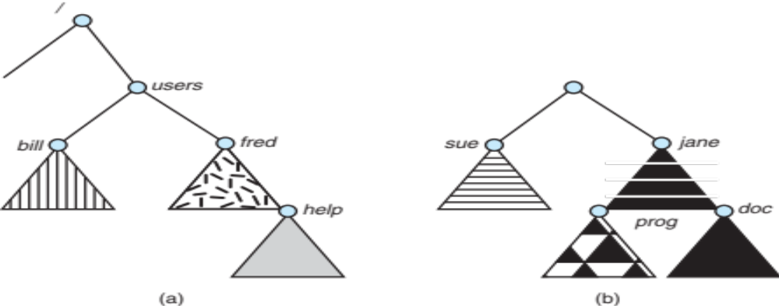
File System Mounting
A file system must be mounted before it can be accessed.
Mounting procedure-operating system is given the name of the device and the mount point i.e. the location within the file structure where the file system is to be attached.
The triangles represent subtrees of directories that are of interest
Figure (a) shows an existing file system, while Figure (b) shows an unmounted volume residing on /device/dsk.

Slide 35

Mount Point
The following figure shows the effects of mounting the volume residing on /device/dsk over /users. If the volume is unmounted, the file system is restored to the situation shown in previous slide.

Slide 36
File Sharing
Sharing of files on multi-user systems is desirable
Sharing may be done through a protection scheme
On distributed systems, files may be shared across a network
Network File System (NFS) is a common distributed file-sharing method
If multi-user system
  User IDs identify users, allowing permissions and protections to be per-user
  Group IDs allow users to be in groups, permitting group access rights
  Owner of a file / directory
  Group of a file / directory

Slide 37
File Sharing – Remote File Systems
Uses networking to allow file system access between systems
  Manually via programs like FTP
  Automatically, seamlessly using distributed file systems
  Semi automatically via the world wide web
Client-server model allows clients to mount remote file systems from servers
  Server can serve multiple clients
  Client and user-on-client identification is insecure or complicated
  NFS is standard UNIX client-server file sharing protocol
  CIFS is standard Windows protocol
  Standard operating system file calls are translated into remote calls
Distributed Information Systems (distributed naming services) such as LDAP, DNS, NIS, Active Directory implement unified access to information needed for remote computing

Slide 38
File Sharing – Failure Modes
All file systems have failure modes
  For example corruption of directory structures or other non-user data, called metadata
Remote file systems add new failure modes, due to network failure, server failure
Recovery from failure can involve state information about status of each remote request
Stateless protocols such as NFS v3 include all information in each request, allowing easy recovery but less security

Slide 39
File Sharing – Consistency Semantics
Specify how multiple users are to access a shared file simultaneously
  Similar to Ch 5 process synchronization algorithms
    Tend to be less complex due to disk I/O and network latency (for remote file systems
  Andrew File System (AFS) implemented complex remote file sharing semantics
  Unix file system (UFS) implements:
    Writes to an open file visible immediately to other users of the same open file
    Sharing file pointer to allow multiple users to read and write concurrently
  AFS has session semantics
    Writes only visible to sessions starting after the file is closed

Slide 40
Protection-physical damage improper access
Reliability is generally provided by duplicate copies of files.
Protection mechanisms provide controlled access by limiting the types of file access that can be made.
File owner/creator should be able to control:
  what can be done
  by whom
Access is permitted or denied depending on several factors, one of which is the type of access requested. Types of access:
  Read
  Write
  Execute
  Append
  Delete
  List

Slide 41
Protection-Access Control
The most common approach to the protection problem is to make access dependent on the identity of the user.
The most general scheme to implement identity- dependent access is to associate with each file and directory an access-control list (ACL).
classifications of users:
Owner. The user who created the file is the owner.
Group. A set of users who are sharing the file and need similar access is a group, or work group.
Universe. All other users in the system constitute the universe.
Permissions and access lists controlled by the manager of the facility.
Only three fields are needed to define protection.
For example, the UNIX system defines three fields of 3 bits each— rwx, where r controls read access, w controls write access, and x controls execution.

Slide 42

Windows 7 Access-Control List Management

Slide 43
Other Protection Approaches_passwords
Associate a password with each file.
Disadvantages:
Number of passwords that a user needs to remember may become large, making the scheme impractical.
If only one password is used for all the files, then once it is discovered, all files are accessible.
Some systems allow a user to associate a password with a subdirectory, rather than with an individual file.
Listing the contents of a directory must be a protected operation

Slide 44
File System Implementation
File-System Structure
File-System Implementation
Directory Implementation
Allocation Methods

Slide 45
File-System Structure
File structure
  Logical storage unit
  Collection of related information
File system resides on secondary storage (disks)
  Provided user interface to storage, mapping logical to physical
  Provides efficient and convenient access to disk by allowing data to be stored, located retrieved easily
Disk provides in-place rewrite and random access
  I/O transfers performed in blocks of sectors (usually 512 bytes)
File control block – storage structure consisting of information about a file
Device driver controls the physical device
File system organized into layers

Slide 46

Layered File System
Each level in the design uses the features of lower levels to create new features for use by higher levels.

Slide 47
File System Layers
Device drivers manage I/O devices at the I/O control layer
  Given commands like “read drive1, cylinder 72, track 2, sector 10, into memory location 1060” outputs low-level hardware specific commands to hardware controller
Basic file system given command like “retrieve block 123” translates to device driver
Also manages memory buffers and caches (allocation, freeing, replacement)
  Buffers hold data in transit
  Caches hold frequently used data
File organization module understands files, logical address, and physical blocks
  Translates logical block # to physical block #
  Manages free space, disk allocation

Slide 48
File System Layers (Cont.)
Logical file system manages metadata information
  Translates file name into file number, file handle, location by maintaining file control blocks (inodes in UNIX)
  Directory management
  Protection
Layering useful for reducing complexity and redundancy, but adds overhead and can decrease performance, Translates file name into file number, file handle, location by maintaining file control blocks (inodes in UNIX)
  Logical layers can be implemented by any coding method according to OS designer

Slide 49
File System Layers (Cont.)
Some operating systems use many file systems within that operating systems.
  Each with its own format (CD-ROM is ISO 9660; Unix has UFS, FFS; Windows has FAT, FAT32, NTFS as well as floppy, CD, DVD Blu-ray, Linux has more than 40 types, with extended file system ext2 and ext3 leading; plus distributed file systems, etc.)
  New File Systems are still arriving – ZFS, GoogleFS, Oracle ASM(Automatic Storage management), FUSE(Filesystem in USErspace)

Slide 50
File-System Implementation
We have system calls at the API level, but how do we implement their functions?
  On-disk and in-memory structures
Boot control block contains info needed by system to boot OS from that volume
  Needed if volume contains OS, usually first block of volume
Volume control block (superblock, master file table) contains volume details
  Total # of blocks, # of free blocks, block size, free block pointers or array
Directory structure organizes the files
  Names and inode numbers, master file table

Slide 51

File-System Implementation (Cont.)
Per-file File Control Block (FCB) contains many details about the file
  inode number, permissions, size, dates
  NFTS stores into in master file table using relational DB structures

Slide 52

In-Memory File System Structures
Mount table storing file system mounts, mount points, file system types
The following figure illustrates the necessary file system structures provided by the operating systems
Figure (a) refers to opening a file, Figure (b) refers to reading a file

Slide 53
In-Memory File System Structures
The open() system call first searches the system-wide open-file table to see if the file is already in use by another process.
If the file is already in use by another process, a per-process open-file table entry is created pointing to the existing system-wide open-file table.
Parts of the directory structure are usually cached in memory to speed directory operations.
Once the file is found, the FCB is copied into a system-wide open-file table in memory.
An entry is made in the per-process open-file table, with a pointer to the entry in the system-wide open-file table and some other fields.
All file operations are then performed via pointer.
UNIX systems refer to it as a file descriptor; Windows refers to it as a file handle.

Slide 54
Directory Implementation
The simplest method of implementing a directory is to use a linear list of file names with pointers to the data blocks.
  Simple to program
  Time-consuming to execute
    Linear search time
    Could keep ordered alphabetically via linked list or use B+ tree
Hash Table – linear list with hash data structure
  Decreases directory search time
  The hash table takes a value computed from the file name and returns a pointer to the filename in the linear list.
  Collisions – situations where two file names hash to the same location
  Only good if entries are fixed size, or use chained-overflow method

Slide 55
Allocation Methods - Contiguous
An allocation method refers to how disk blocks are allocated for files:
Contiguous allocation – each file occupies set of contiguous blocks
  Best performance in most cases
  Simple – only starting location (block #) and length (number of blocks) are required
  Problems include finding space for file, knowing file size, external fragmentation,
  Solution: Copy an entire file system onto another disk. The original disk is then freed completely, creating one large contiguous free space. We then copy the files back onto the original disk by allocating contiguous space from this one large hole.
  Another problem with contiguous allocation is determining how much space is needed for a file.
  If we allocate too little space to a file, we may find that the file cannot be extended.

Slide 56

Contiguous Allocation
If the file is n blocks long and starts at location b, then it occupies blocks b, b + 1, b + 2, ..., b + n 1. The directory entry for each file indicates the address of the starting block and the length of the area allocated for this file.
For sequential access, the file system remembers the disk address of the last block referenced and, when necessary, reads the next block.
For direct access to block i of a file that starts at block b, we can immediately access block b + i.

Slide 57
Extent-Based Systems
Many newer file systems (i.e., Veritas File System) use a modified contiguous allocation scheme(a contiguous chunk of space is allocated initially. Then, if that amount proves not to be large enough, another chunk of contiguous space, known as an extent, is added.)
Extent-based file systems allocate disk blocks in extents
An extent is a contiguous block of disks
  Extents are allocated for file allocation
  A file consists of one or more extents

Slide 58
Allocation Methods - Linked
Linked allocation – each file a linked list of blocks
  File ends at nil pointer
  No external fragmentation
  Each block contains pointer to next block
  No compaction, external fragmentation
  Free space management system called when new block needed
  Improve efficiency by clustering blocks into groups but increases internal fragmentation
  Reliability can be a problem
  Locating a block can take many I/Os and disk seeks

Slide 59
Allocation Methods – Linked (Cont.)
FAT (File Allocation Table) variation
  Beginning of volume has table, indexed by block number
  Much like a linked list, but faster on disk and cacheable
  New block allocation simple

Slide 60
Linked Allocation
Linked allocation solves all problems of contiguous allocation.
Each file is a linked list of disk blocks: blocks may be scattered anywhere on the disk.
The directory contains a pointer to the first and last blocks of the file.
To create a new file, we simply create a new entry in the directory.
With linked allocation, each directory entry has a pointer to the first disk block of the file.
There is no external fragmentation with linked allocation.
A file can continue to grow as long as free blocks are available.
Disadvantages:
1. it can be used effectively only for sequential-access files.
2. it is inefficient to support a direct-access capability for linked-allocation files.
3. space required for the pointers
Solution: collect blocks into multiples, called clusters, and to allocate clusters rather than blocks.

Slide 61
Linked Allocation
Clusters can be used to improve the disk-access time.
Reliability: files are linked together by pointers scattered all over the disk, and consider what would happen if a pointer were lost or damaged.

Slide 62

Linked Allocation

Slide 63
File-Allocation Table
FAT(file-allocation table )-is an variation on linked allocation.
Here a section of disk at the beginning of each volume is set aside to contain the table.
The table has one entry for each disk block and is indexed by block number.
The directory entry contains the block number of the first block of the file.
The table entry indexed by that block number contains the block number of the next block in the file.
This chain continues until it reaches the last block, which has a special end-of-file value as the table entry.
An unused block is indicated by a table value of 0.

Slide 64

File-Allocation Table

Slide 65
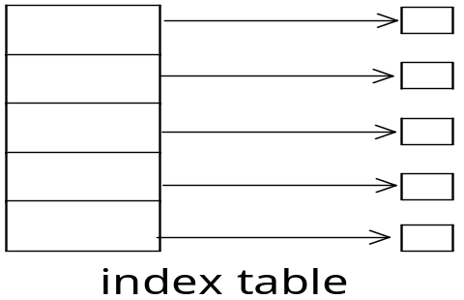
Allocation Methods - Indexed
In the absence of a FAT, linked allocation cannot support efficient direct access.
Indexed allocation solves this problem by bringing all the pointers together into one location: the index block.
Indexed allocation
  Each file has its own index block(s) of pointers to its data blocks
  The i ^{th} entry in the index block points to the i^{th} block of the file.
  To find and read the i^{th} block, we use the pointer in the i^{th} index-block entry.
Logical view

Slide 66

Example of Indexed Allocation

Slide 67
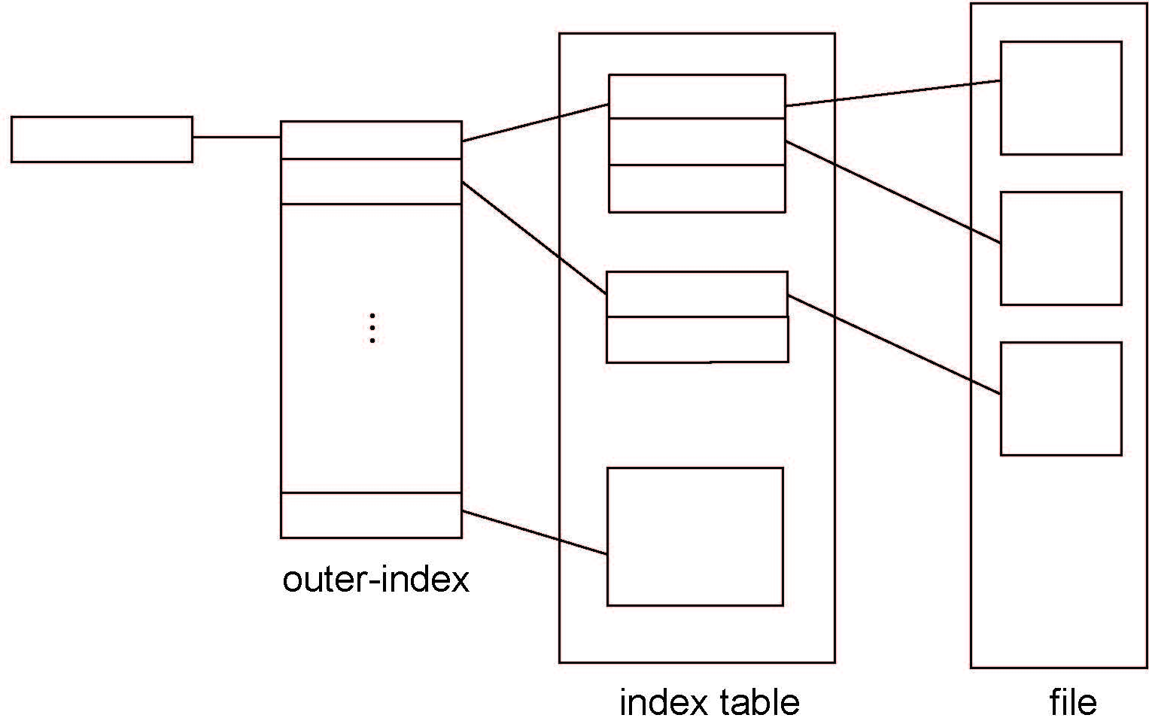
Indexed Allocation – Mapping (Cont.)

Slide 68

Combined Scheme: UNIX UFS
4K bytes per block, 32-bit addresses
More index blocks than can be addressed with 32-bit file pointer

Slide 69
Performance
Best method depends on file access type
  Contiguous great for sequential and random
Linked good for sequential, not random
Declare access type at creation -> select either contiguous or linked
Indexed more complex
  Single block access could require 2 index block reads then data block read
  Clustering can help improve throughput, reduce CPU overhead

Slide 70
Performance (Cont.)
Adding instructions to the execution path to save one disk I/O is reasonable
  Intel Core i7 Extreme Edition 990x (2011) at 3.46Ghz = 159,000 MIPS
    http://en.wikipedia.org/wiki/Instructions_per_second
  Typical disk drive at 250 I/Os per second
    159,000 MIPS / 250 = 630 million instructions during one disk I/O
  Fast SSD drives provide 60,000 IOPS
    159,000 MIPS / 60,000 = 2.65 millions instructions during one disk I/O

Slide 71
Free-Space Management
File system maintains free-space list to track available blocks/clusters
  (Using term “block” for simplicity)
Bit vector or bit map (n blocks)
0
1
2
n-1
…
1 ⇒ block[i] free
0 ⇒ block[i] occupied
bit[i] =

Block number calculation
(number of bits per word) *
(number of 0-value words) +
offset of first 1 bit
CPUs have instructions to return offset within word of first “1” bit

Slide 72
Free-Space Management (Cont.)
Bit map requires extra space
  Example:
block size = 4KB = 2¹² bytes
disk size = 2⁴⁰ bytes (1 terabyte)
n = 2⁴⁰/2¹² = 2²⁸ bits (or 32MB)
if clusters of 4 blocks -> 8MB of memory
Easy to get contiguous files

Slide 73

Linked Free Space List on Disk
Linked list (free list)
  Cannot get contiguous space easily
  No waste of space
  No need to traverse the entire list (if # free blocks recorded)

Slide 74
Free-Space Management (Cont.)
Grouping
  Modify linked list to store address of next n-1 free blocks in first free block, plus a pointer to next block that contains free-block-pointers (like this one)
Counting
  Because space is frequently contiguously used and freed, with contiguous-allocation allocation, extents, or clustering
    Keep address of first free block and count of following free blocks
    Free space list then has entries containing addresses and counts

Slide 75
Free-Space Management (Cont.)
Space Maps
  Used in ZFS
  Consider meta-data I/O on very large file systems
    Full data structures like bit maps couldn’t fit in memory -> thousands of I/Os
  Divides device space into metaslab units and manages metaslabs
    Given volume can contain hundreds of metaslabs
  Each metaslab has associated space map
    Uses counting algorithm
  But records to log file rather than file system
    Log of all block activity, in time order, in counting format
  Metaslab activity -> load space map into memory in balanced-tree structure, indexed by offset
    Replay log into that structure
    Combine contiguous free blocks into single entry

Slide 76
Efficiency and Performance
Efficiency dependent on:
  Disk allocation and directory algorithms
  Types of data kept in file’s directory entry
  Pre-allocation or as-needed allocation of metadata structures
  Fixed-size or varying-size data structures

Slide 77
Efficiency and Performance (Cont.)
Performance
  Keeping data and metadata close together
  Buffer cache – separate section of main memory for frequently used blocks
  Synchronous writes sometimes requested by apps or needed by OS
    No buffering / caching – writes must hit disk before acknowledgement
    Asynchronous writes more common, buffer-able, faster
  Free-behind and read-ahead – techniques to optimize sequential access
  Reads frequently slower than writes

Slide 78
Page Cache
A page cache caches pages rather than disk blocks using virtual memory techniques and addresses
Memory-mapped I/O uses a page cache
Routine I/O through the file system uses the buffer (disk) cache
This leads to the following figure

Slide 79
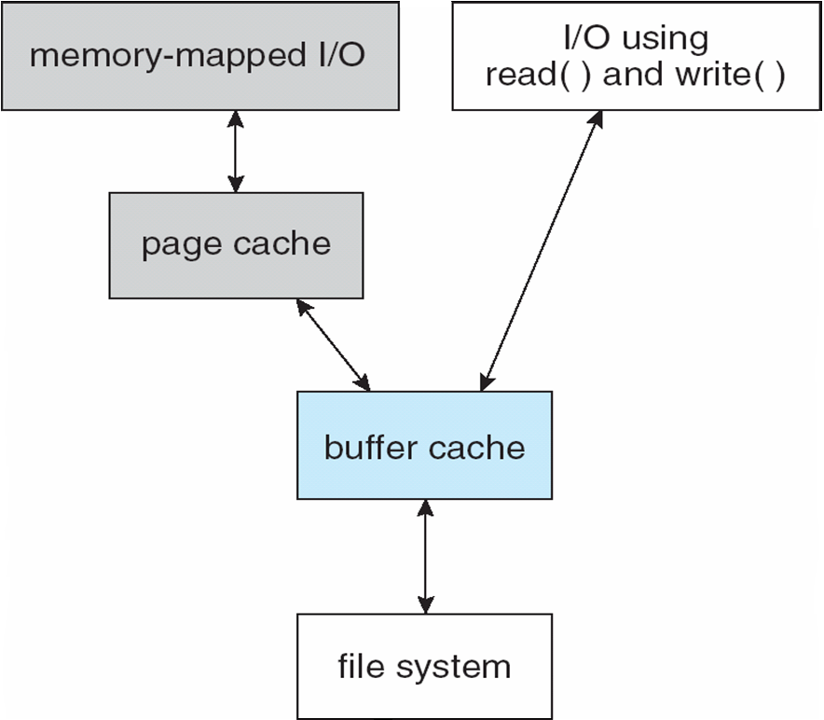
I/O Without a Unified Buffer Cache

Slide 80
Unified Buffer Cache
A unified buffer cache uses the same page cache to cache both memory-mapped pages and ordinary file system I/O to avoid double caching
  But which caches get priority, and what replacement algorithms to use?

Slide 81
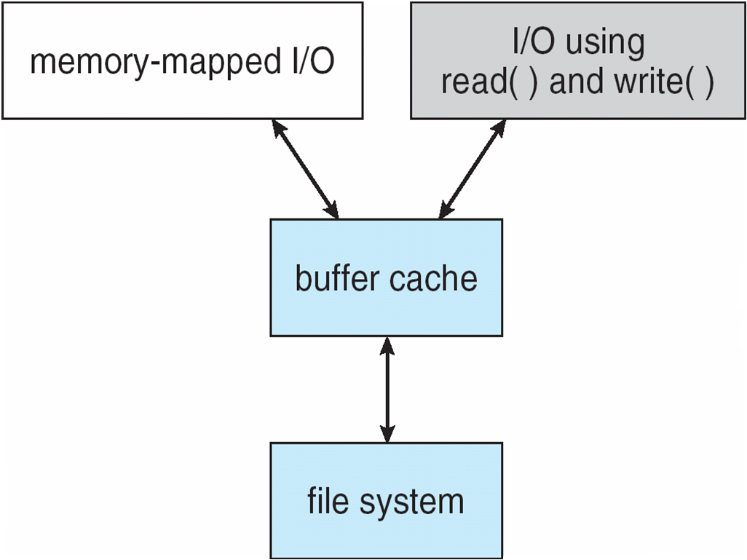
I/O Using a Unified Buffer Cache

Slide 82
Recovery
Consistency checking – compares data in directory structure with data blocks on disk, and tries to fix inconsistencies
  Can be slow and sometimes fails
Use system programs to back up data from disk to another storage device (magnetic tape, other magnetic disk, optical)
Recover lost file or disk by restoring data from backup

